Slide 1


Examination System

Slide 2






Team Members
Team Members
Hager Mohamed
Mohamed Amer
Mohamed Ashraf
Rewaa Srour
Hend Mohamed

Slide 3

Outline
Introduction.
ERD & Mapping.
Stored procedures.
Reports in SSRS
Power BI Dashboard.
Desktop Application.
DataWareHouse.
ETL for DWH.
Cube.

Slide 4


Introduction
The Examination System is an all-encompassing platform meticulously crafted to streamline the orchestration of educational assessments, student records, and reporting capabilities. Tailored to meet the varied requirements of educational institutions, instructors, and students, this system offers robust features. It aims to simplify examination processes, monitor student advancements, and generate insightful reports, contributing to a more efficient and organized educational experience.
Back to OutLine Page

Slide 5
Used Technologies & Tools
SQL Server Management Studio.
SQL Data Generator.
SQL Server Report Service
SQL Server Integration Service
SQL Server Analysis Service.
Power BI.
Visual Studio.
Python Programming Language.

Slide 6
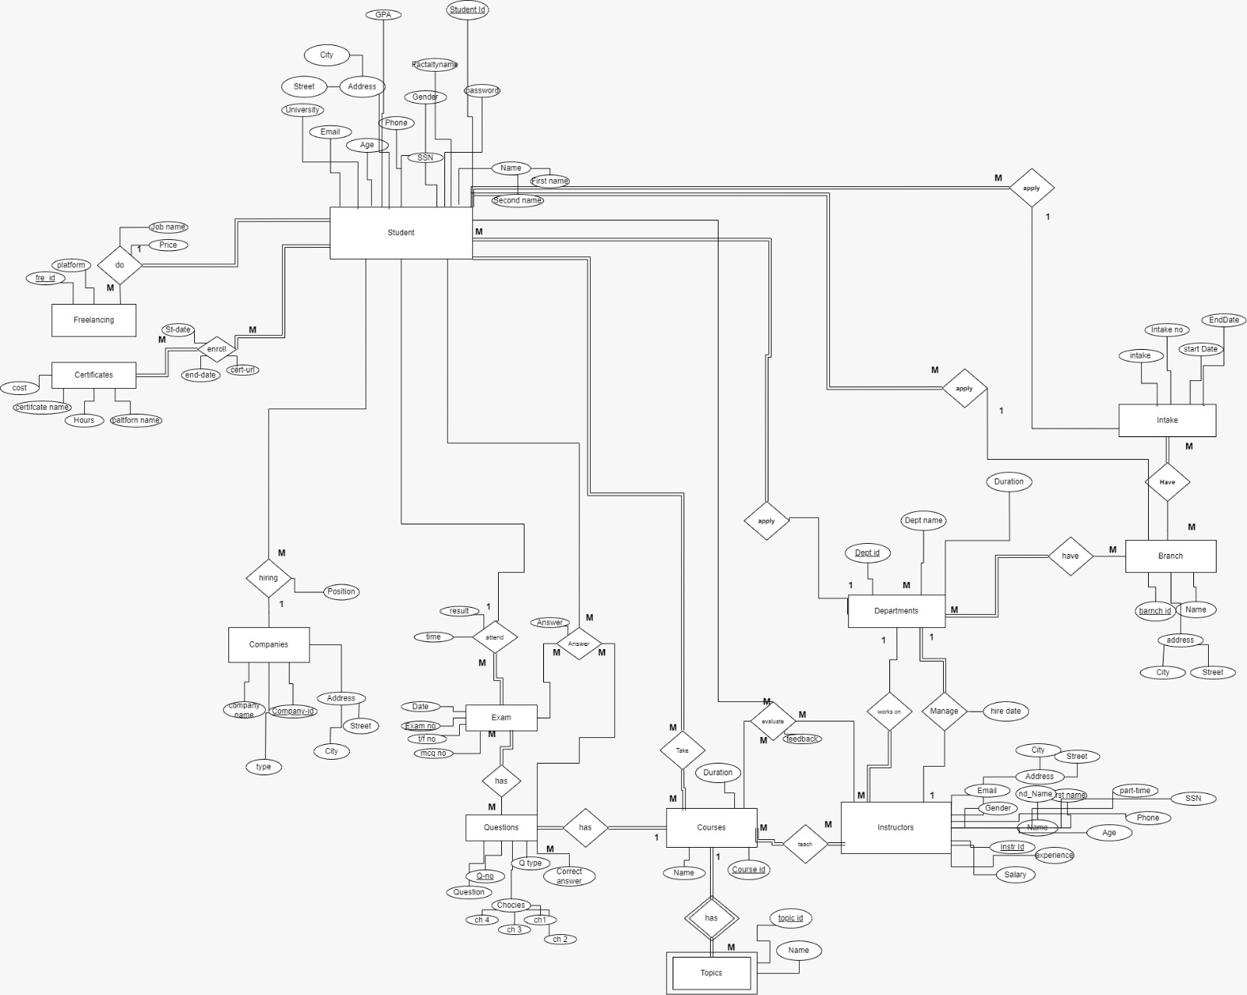
ERD

Slide 7
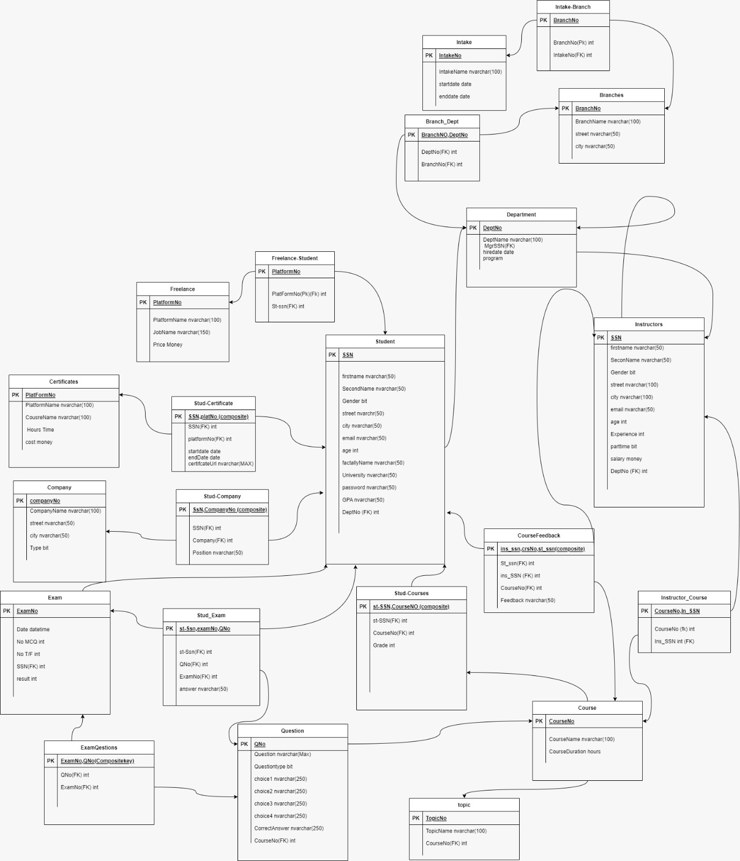
Mapping

Slide 8

Tables:
Select ,Insert update and delete for all tables
Exam generation:
_RANDOMEXAMGENERATOR
Exam Answers:
_EXAMANSWERS
Exam Correction:
_CORRELATION_EXAM
Stord for SSRS Reports
Stored procedures
Back to OutLine Page

Slide 9
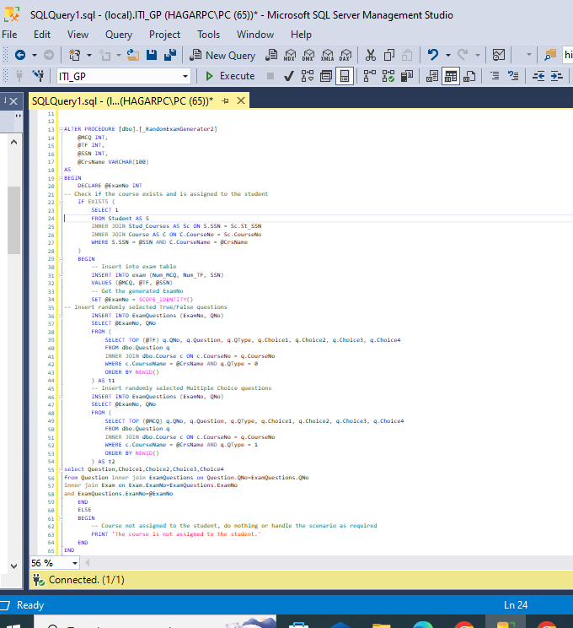
Exam generation
Back to OutLine Page

Slide 10
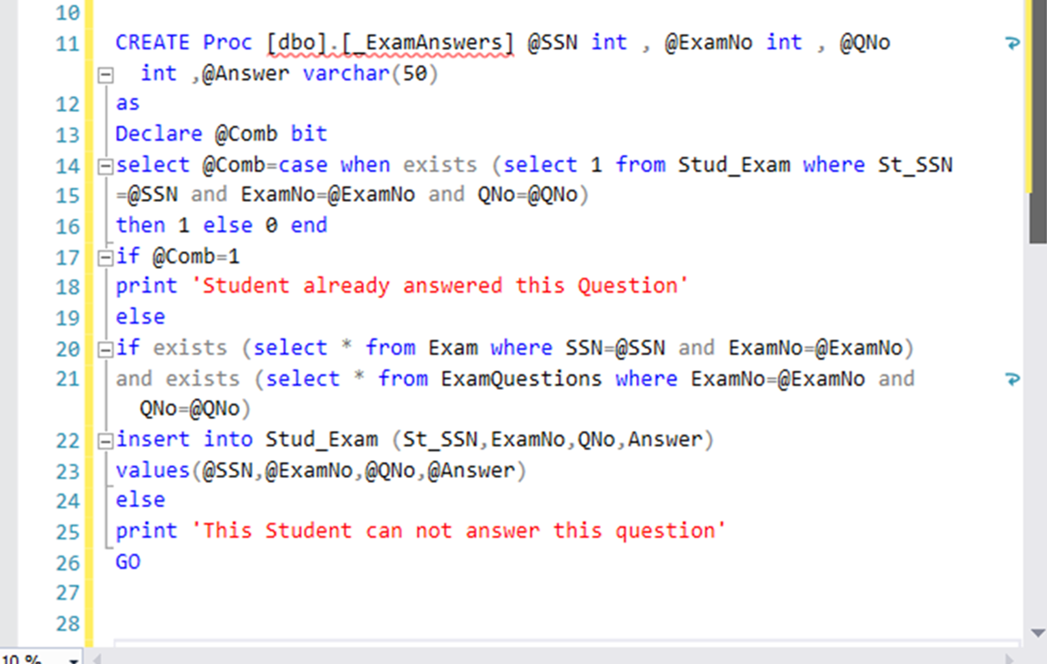
Exam Answers
Back to OutLine Page

Slide 11
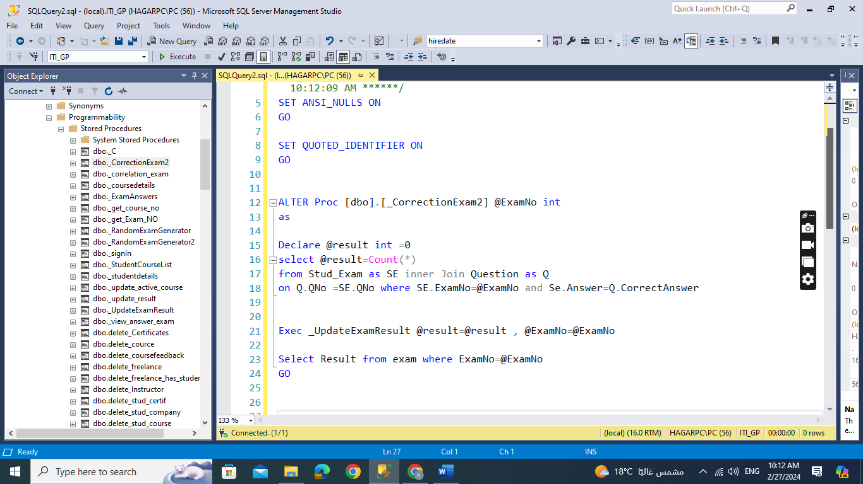
Exam Correction
Back to OutLine Page

Slide 12
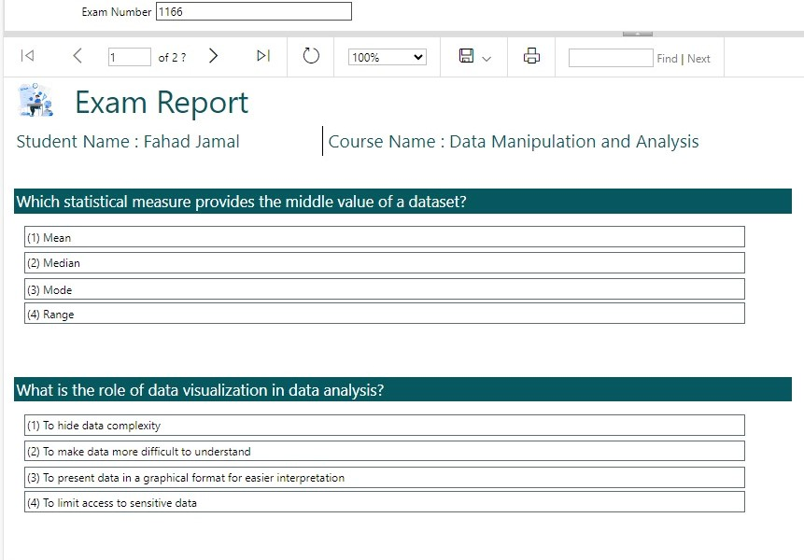
SSRS Repots
Report that returns the students information according to Department No
Report that takes the student ID and returns the grades of the student in all courses.
Report that takes the instructor ID and returns the name of the courses that he teaches and the number of student per course.
Report that takes course ID and returns its topics.
Report that takes exam number and returns the Questions in it and chocies.
Report that takes exam number and the student ID then returns the Questions in this exam with the student answers.
Deploy All Reports in Power BI
Back to OutLine Page

Slide 13
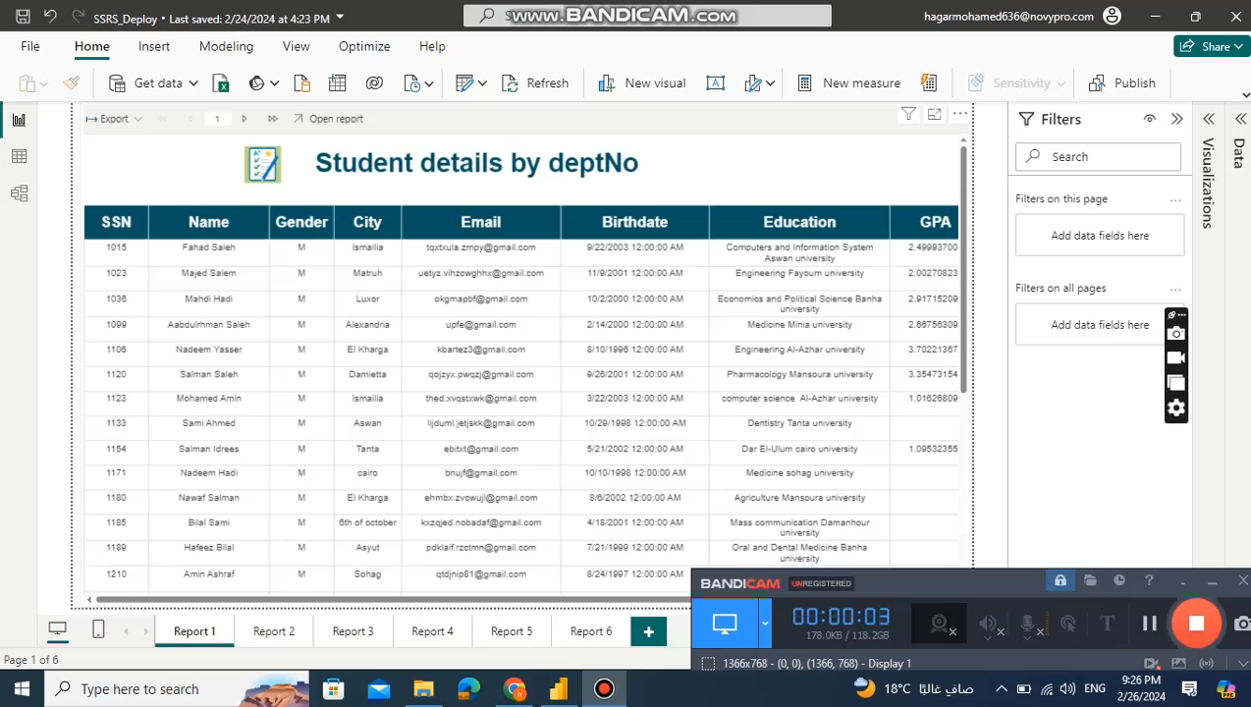
Back to OutLine Page
Notes:
.rdl upload on power bi service _> power bi select pajenated report create report acsses نختار الريبورت اللي موجوده في الSSRS

Slide 14
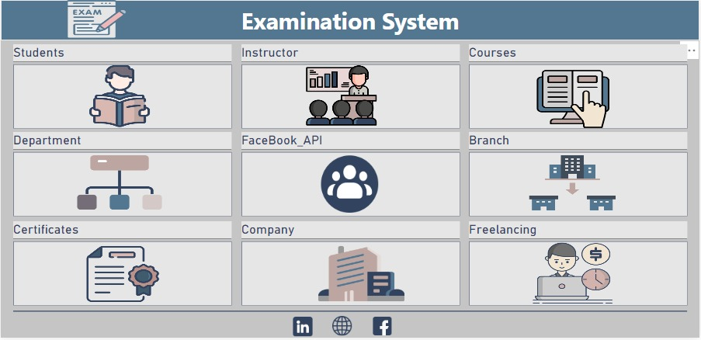
Dashboard
Student :
Student Overview
Student Details
Student Distribution
Comparesion
Graduated Student
Instructor :
Instructor Overview
Instructor Details
Instructor Data (Drill through)
Courses :
course Overview
course Details
Exam Overview
Department :
Department Overview
Shifting Career
Department Data
Department Goal
Managers
Branch :
Branch Overview
Branch Details
Branch Data
Branch Map
Certificates :
Certificate Overview
Certificate Details
Certificate Data
Freelancing :
Freelance Overview
Freelance Data
Company :
Company Overview
Company Details
Company Data
Facebook API :
social media data for team

Slide 15

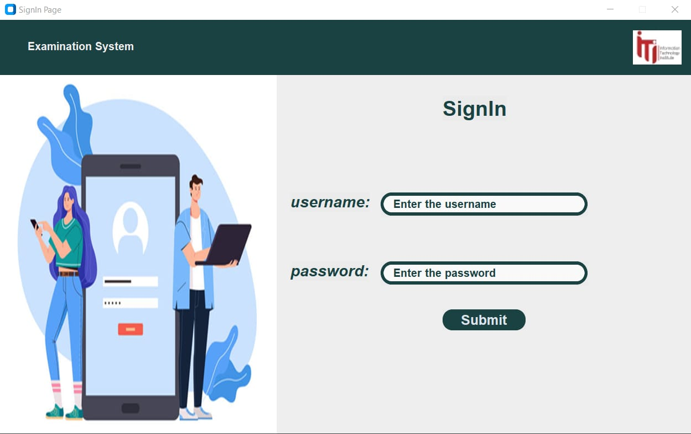
Desktop Application
Back to OutLine Page

Slide 16

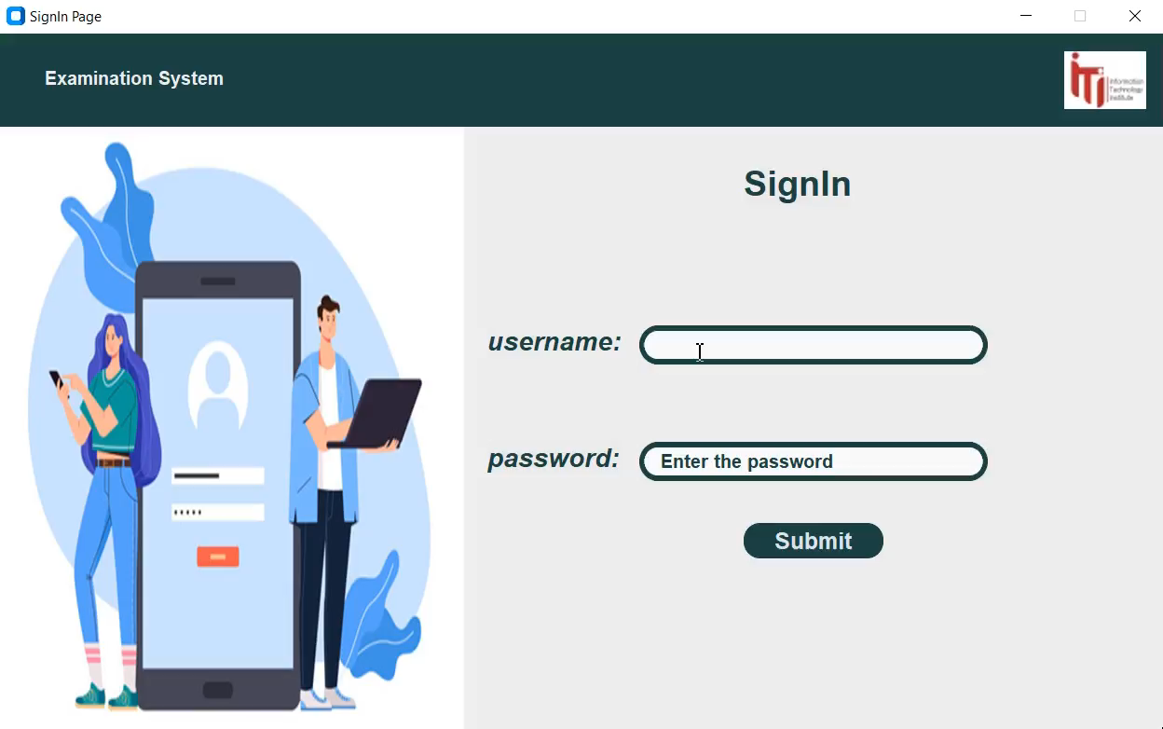
Back to OutLine Page

Slide 17
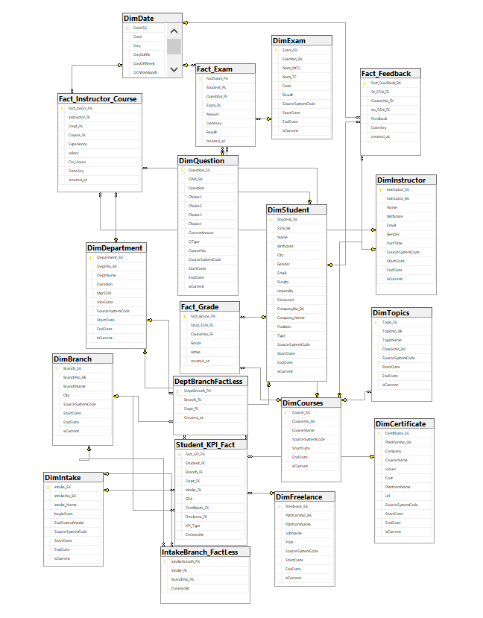
DataWareHouse
SnowFlake Model
Fact Tables :
IntakeBranch_FactLess
DeptBranchFactLess
Student_KPI_Fact
Fact Instructor_Course
Fact_Feedback
Fact_Grade
Fact_Exam
Dimension Tables :
DimStudent
DimDepartment
DimBranch
DimIntake
DimFreelance
DimCertificate
DimCourses
DimTopics
DimInstructor

Slide 18
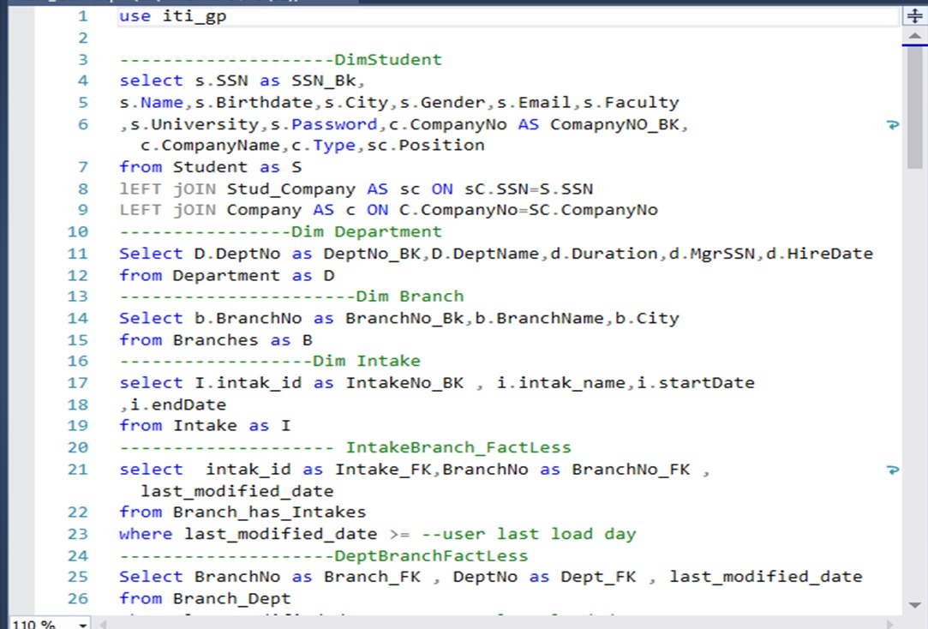
Source Query Execution
Back to OutLine Page

Slide 19

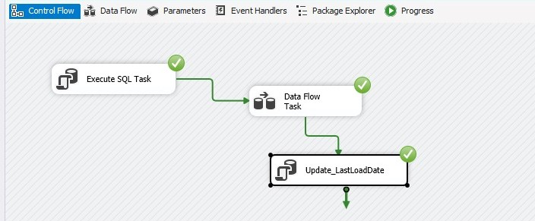
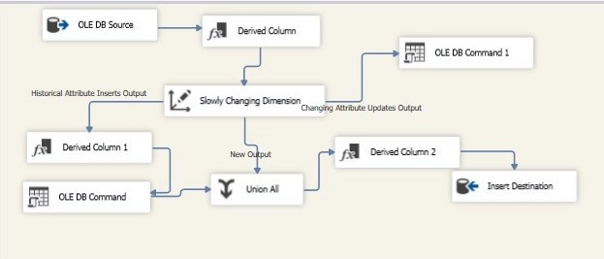
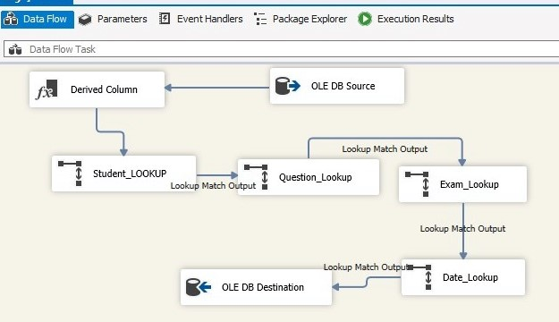
ETL for Fact Tables
ETL for Dimension Tables
Back to OutLine Page

Slide 20
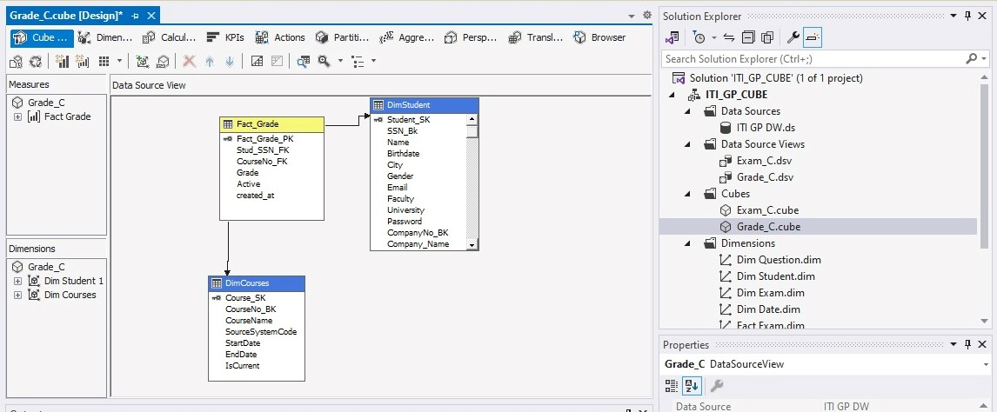
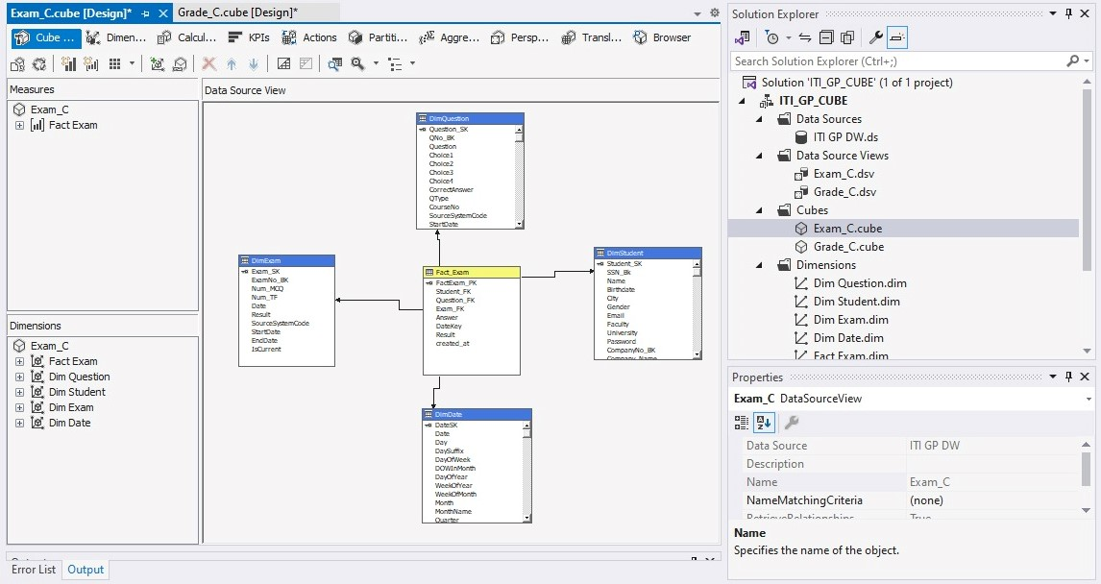
Cube

Slide 21
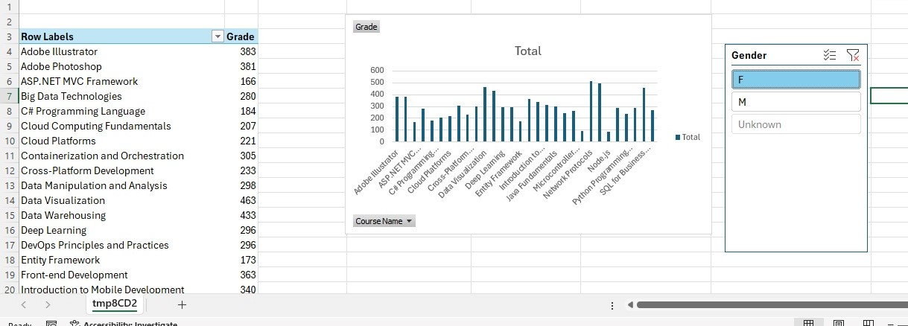
Cube

Slide 22

Back to OutLine Page

